Slide 1

ELEC-E8408 Hiking Tour Assistant Group B: Markus Mattsson Vilma Väisänen Teemu RauHA
AGENDA

Slide 2
ELEC-E8408 Hiking Tour Assistant Group B: Markus Mattsson Vilma Väisänen Teemu RauHA
Overview (Context Diagram)
System Interfaces
Requirements
Test Report Summary
Design Report Summary
User Manual
Live Demo
AGENDA

Slide 3
Overview

Slide 4
Overview
INterfaces

Slide 5
Component | Inputs | Outputs | Timing Constraints | Accuracy Metrics
LilyGo Smartwatch (ESP32) | Button press, Accelerometer (BMA423), touch screen | BLE data to Arduino, Display updates | Max response delay: 200ms | Step count: ±2% accuracy
Arduino Mega | BLE data from smartwatch, buttons | LCD updates, SRAM storage | Sync under 5 sec | N/A
LCD Screen (16x2, I2C) | I2C data from Arduino | Displays session data | Max update delay: 50ms | Readability at 30cm distance
HW & SW
INterfaces
Module | Inputs | Outputs | Data Format | Performance Constraints
Watch Firmware (ESP32) | Button press, Accelerometer | BLE sync data, UI display updates | JSON-like BLE payload | Max UI update delay: 200ms
Arduino Firmware | BLE session data | LCD output, SRAM storage | SRAM-stored stats | Sync within 5 sec
LCD Module | I2C data from Arduino | Displayed text | 16x2 character format | Response time < 50ms

Slide 6
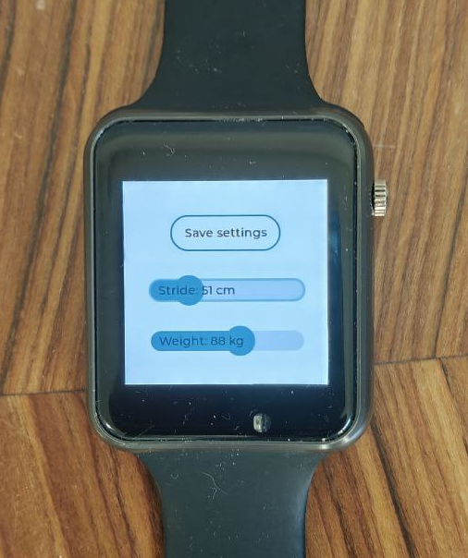
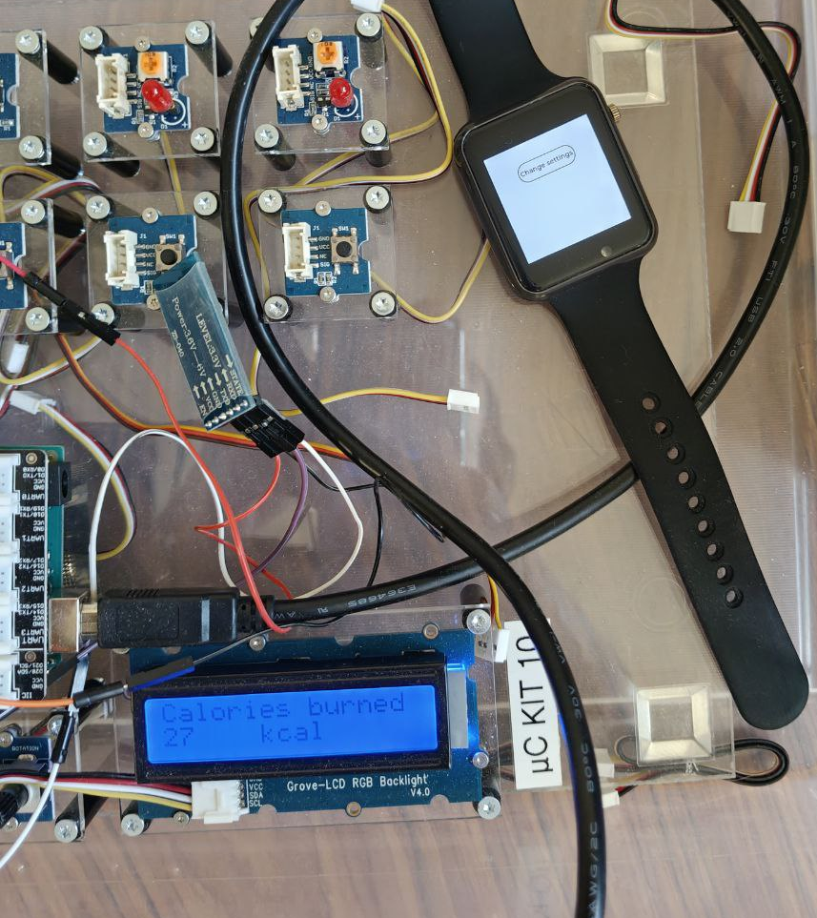
Component | Inputs | Outputs | Interaction Method | Performance Constraints
LiLyGo Smartwatch UI | Button press, Touchscreen taps | 1,54-inch screen showing the GUI | Button & touchscreen | Max UI update delay: 200ms
Watch Accelerometer (BMA423) | User moving the watch | Step count data | Walking, jogging, running, etc | Step count accuracy ±2%
Arduino UI | Power on, button press | LCD screen displays session statistics | Turning power on & button press | Response time < 50ms
User Interface

Slide 7
FR-1-01: When turned off, after user presses the power button for 3 s (seconds), the watch shall turn on and start the initial program.
FR-1-02: Watch shall show the program standby view after turning on and keep the view on the screen until other required function is initiated.
FR-1-03: The standby view shall state the application name - “Hiking Assistant” and also present a touch-screen button for accessing the settings.
FR-1-04: While in the standby view, pressing the watch power button for 1 s shall start the hiking session.
FR-1-05: During an active hiking session, the watch shall count the steps taken by the user by listening to the interrupts from the BMA423 acceleration sensor.
FR-1-06: During an active hiking session the watch shall calculate distance traveled by multiplying the stride length with the steps count.
FR-1-07: Watch shall display steps count, distance, and time elapsed during an active hiking session. This session statistics shall be updated after each interrupt from the acceleration sensor.
FR-1-08: During an active hiking session, the watch shall allow the user to stop the hiking session by pressing the power button for 1 s.
FR-1-09: The watch shall save the hiking data to SRAM memory after the hike has been stopped.
FR-1-10: After stopping the hiking session, the watch shall attempt to synchronize with the Arduino via BLE. If the synchronization is unsuccessful, the watch will attempt 3 more times with 10 second intervals. If unsuccessful after re-attempts, the watch shall notify the user with a text or icon on the screen.
FR-1-11: Watch shall allow user configuration of stride length based on height in the settings.
FR-1-12: Watch shall display information in a readable format, ensuring optimal visibility in both dark and bright conditions.
FR-1-13: Watch shall allow the user to enable/disable automatic Bluetooth discovery for synchronization with Arduino.
FR-1-14: Watch shall have an option for manually initiating the BLE synchronization.
FR-1-15: When turned on, the watch shall turn off after user presses the power button for 3 seconds.
Functional
Requirements
(watch)

Slide 8
Watch-Arduino Sync Requirements (FR-2-XX)
FR-2-01: Watch shall initiate synchronization with Arduino at the end of a hiking session or upon user request.
FR-2-02: Watch shall transmit steps, distance, duration, and user information to Arduino via Bluetooth.
FR-2-03: Arduino shall acknowledge data receipt and confirm synchronization status to the watch.
FR-2-04: Watch shall notify the user whether synchronization was successful or failed.
FR-2-05: Watch may attempt automatic synchronization when in range of the Arduino, if enabled.
FR-2-06: Watch may establish a Wi-Fi connection with the Arduino if enabled from settings.
Arduino Requirements (FR-3-XX)
FR-3-01: Once turned on by attaching the power cable, the Arduino shall begin to poll the BLE sensor HM-10 for incoming transmissions.
FR-3-02: Arduino shall parse the received hiking session data into separate variables and store them into SRAM.
FR-3-03: Arduino shall calculate estimated calories burned using the stored hiking variables.
FR-3-04: Arduino shall adjust the calorie calculation formula if elevation data is available.
FR-3-05: Arduino shall display session statistics (steps, distance, duration, and calories) on the LED screen. All statistics may not be shown at the same time, and user shall have a way to scroll between different statistics.
Functional
Requirements
(Continued)

Slide 9
Requirement | Value
Step count accuracy | ±2%, comparable to commercial smartwatches.
UI performance | Watch screen refresh rate at least 30 FPS. Maximum response time for user inputs (touch interactions) should be 200ms.
Battery | At least 12 hours continuous use.
Data Synchronization | BT synchronization between smartwatch and Arduino should be done in less than 5 seconds after initialization.
Environmental conditions | Temperature range to function in Finnish nature, -20°C to + 40°C.
Performance
Requirements

Slide 10
Objective:
Ensure HTA system meets all requirements through comprehensive testing.
Strategy:
Unit tests: Smartwatch and Arduino tests.
Integration tests: Synchronization and data transfer between watch and Arduino.
System tests: Validate complete system functionality and reliability.
Risk Mitigation:
Potential Bluetooth interference and data loss during sync.
Accurate distance calculation and calorie estimation.
Battery life and system reliability under various conditions.
Key Test Cases:
Watch Functionality: Start & stop sessions, step counting, distance calculation.
Data Synchronization: Bluetooth sync between watch and Arduino.
Arduino Processing: Data reception, calorie calculation, and display on LCD.
Goal:
Deliver a reliable and user-friendly HTA system that meets all requirements and performs effectively in real-world hiking environments.
Test Report Summary

Slide 11
Strategy:
LiLyGo Smartwatch: Focus on data collection, user interaction, and BT communication.
Arduino Mega: Handle data processing, calorie calculation, and display of hiking statistics.
Key Design Elements
Bluetooth Communication: Reliable data transfer between smartwatch and Arduino, with error detection and retry mechanisms.
Data Processing: Efficient program for step counting, distance calculation, and calorie estimation.
User Interface: Intuitive design for easy navigation and real-time data display on both smartwatch and LCD screen.
Risk Mitigation:
Bluetooth Stability: Address potential interference and ensure robust data synchronization.
Resource Management: Optimize battery usage and memory allocation for prolonged operation.
Environmental Adaptability: Ensure functionality across varying outdoor conditions.
Goal:
Provide a comprehensive overview of the system's architecture, detailing how the software and hardware components are designed to meet the project's requirements.
Design Report Summary

Slide 12
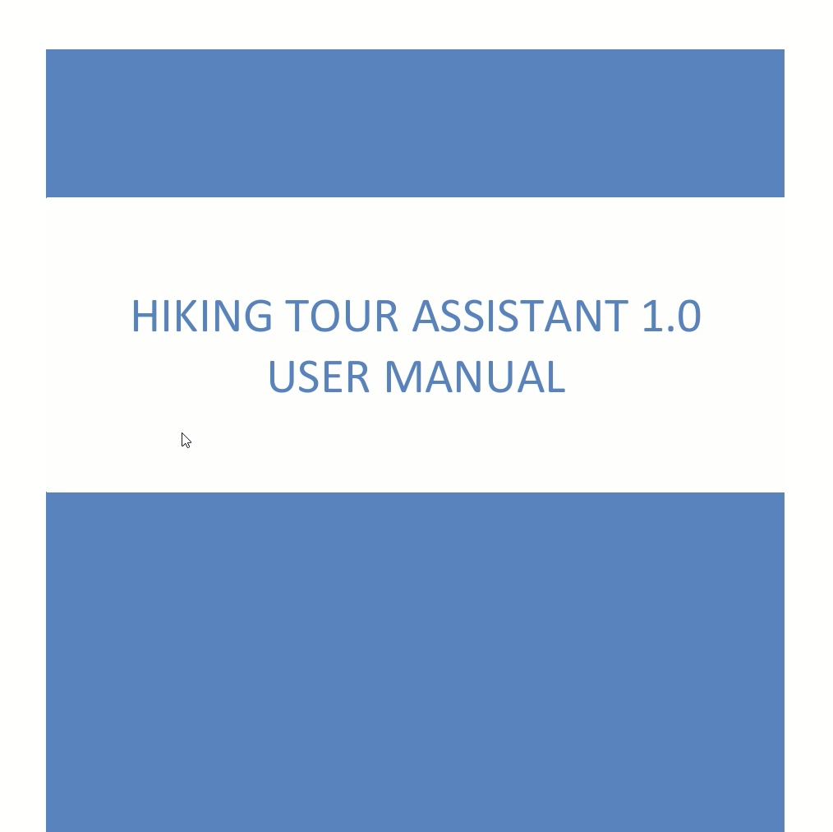
User Manual

Slide 13
Live demo Time!
Hiking tour assistant

Slide 14

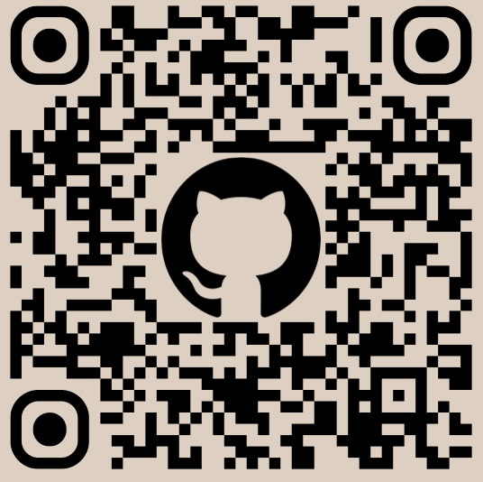


THANK YOU!
Steps: 3456
End session
Our repository can be found at:
github.com/Kalamadnas/E8408_Hiking_Assistant

Slide 15
Image sources:
https://www.biztechcs.com/blog/features-apple-watch-hiking-app-must-have/
https://chat.mistral.ai/

